Slide 1
Postman API Platform
The Postman testing tool is a complete API development platform with various built-in tools that support every stage of the API lifecycle. Postman tool allows you to design, mock, debug, automated testing, document, monitor and publish the APIs
Presenter by Anis Amira

Slide 2
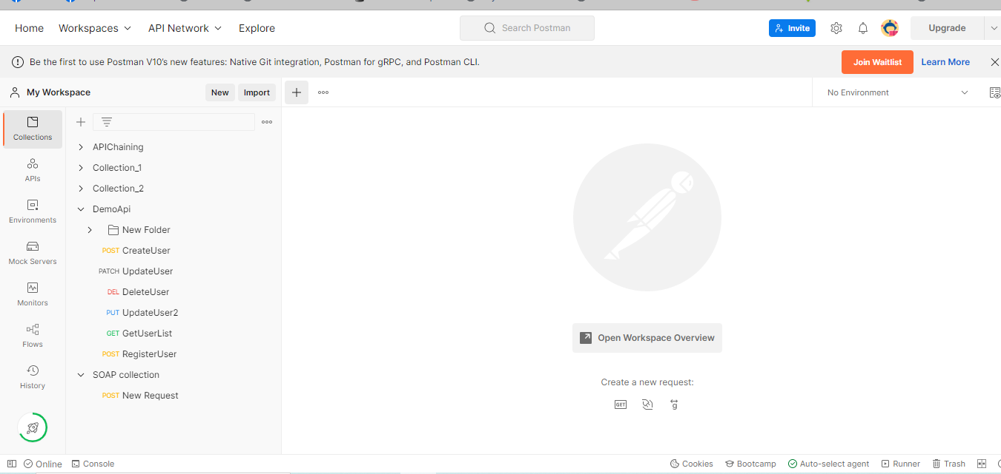
How to add API Request Run and check Response
1. Click icon +

Slide 3
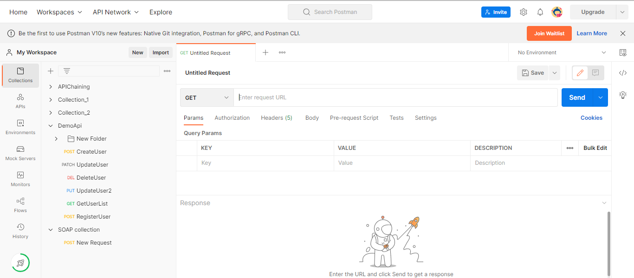
2. Now can create request here

Slide 4
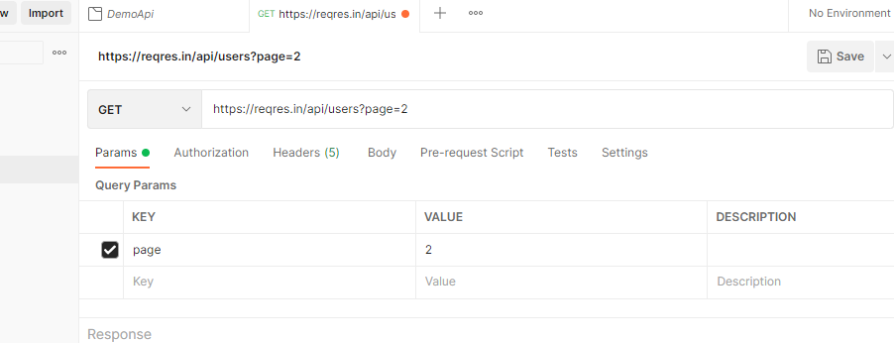
https://reqres.in/ (sample api)
Click request link and paste at the form

Slide 5
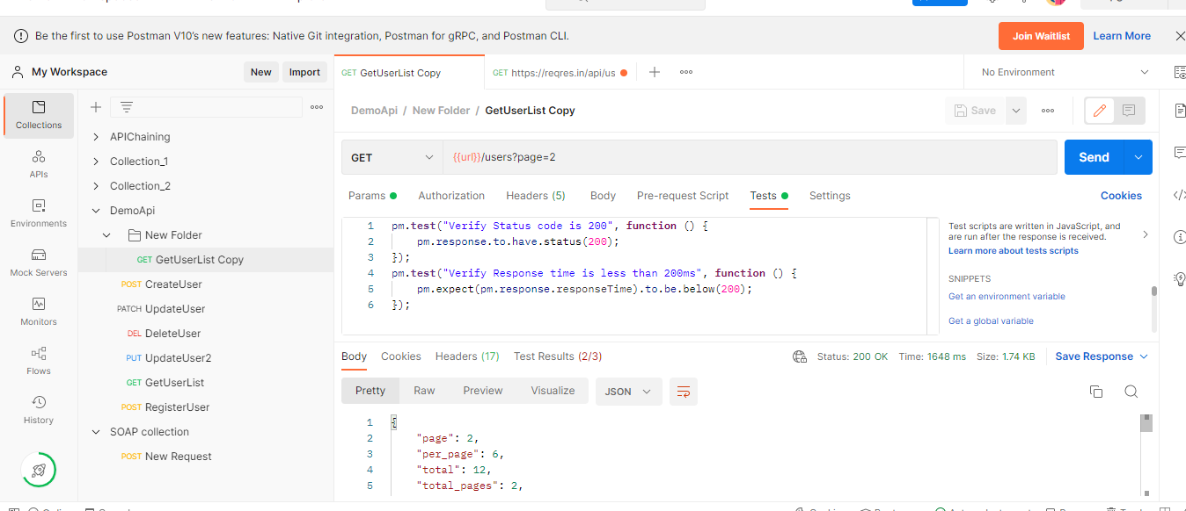
Click send and you can see the response

Slide 6
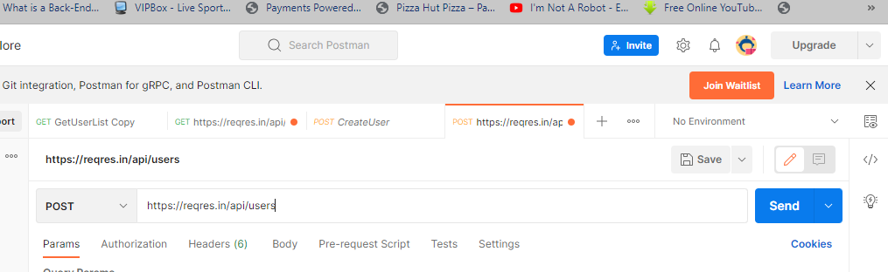
How to add POST API Request Run and check Response
Click + icon and choose post
Go to https://reqres.in/ website and click post
Click request post and copy and paste at form postman.

Slide 7
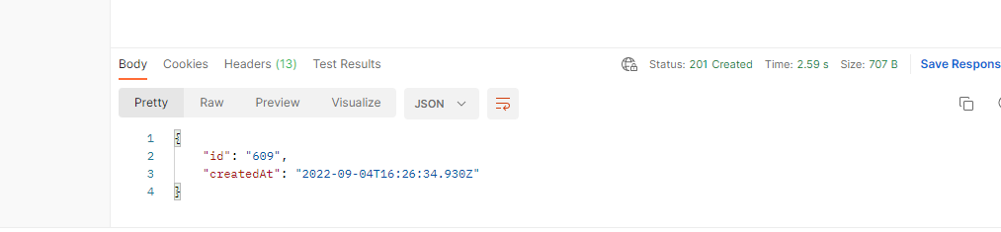
Click send and can see response

Slide 8
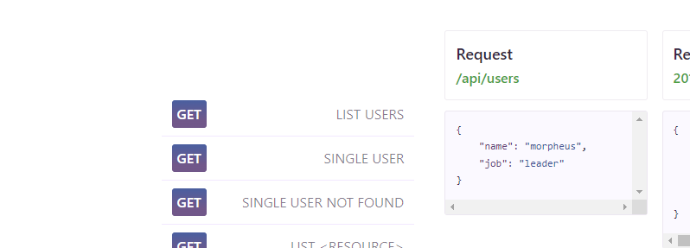
Click body and click raw
Copy body at https://reqres.in/ and paste at raw

Slide 9
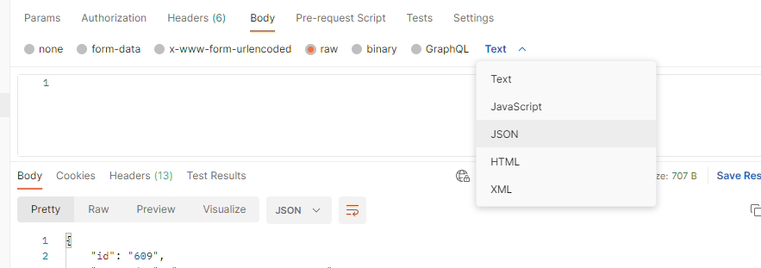
Click text and choose json

Slide 10
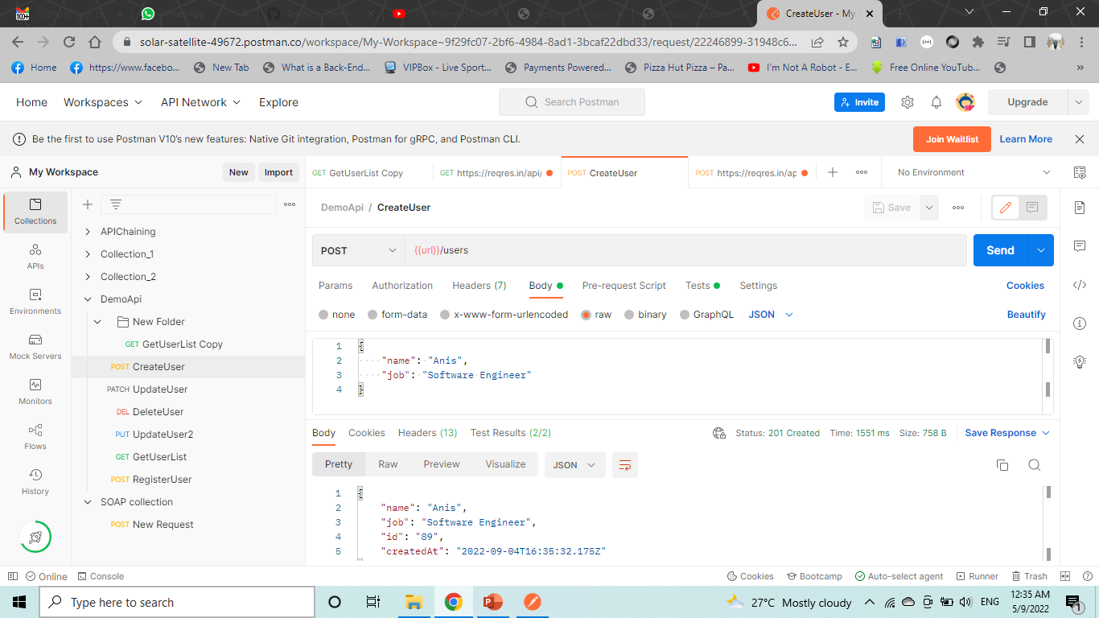
Click send and you can see response

Slide 11
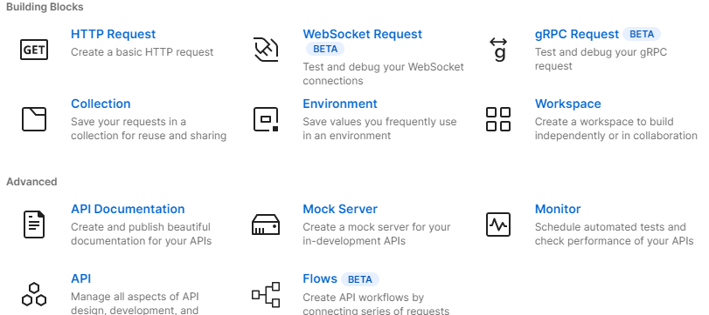
How to Create Collections
Click new
Click collection

Slide 12
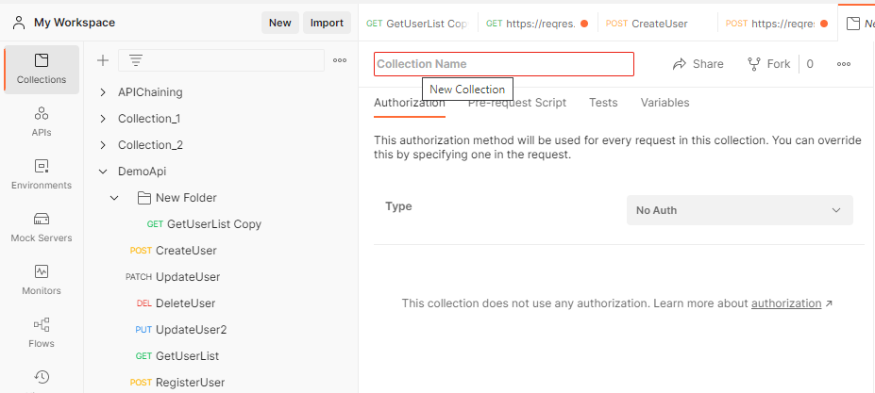
Give name collection

Slide 13
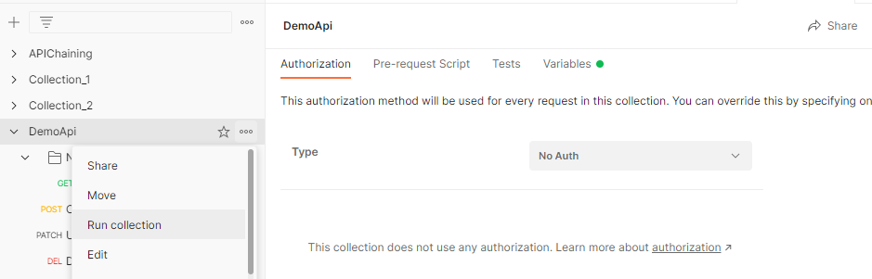
How to run a collection and How to analyse the result
Click collection and click 3 dots and click run collection

Slide 14
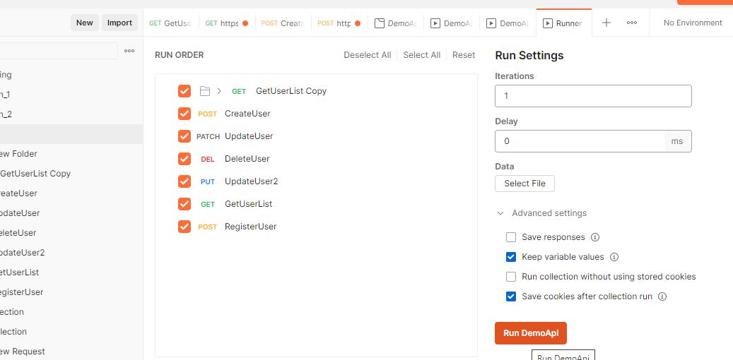
Click collection name

Slide 15
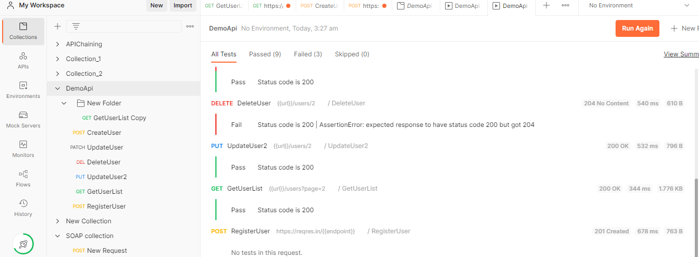
You can see the result pass and failed

Slide 16
How to create variables
WHAT variables
- elements(data store) that can take different values
WHY
- to reuse values at multiple places avoid repetition
- to avoid re-work when value changes

Slide 17
Click 3 dots(…) at collection name and click edit
Click variable
Enter url in variable column
Enter https://reqres.in/api in column initial value and current value
Replace https://reqres.in/api with {{url}}

Slide 18
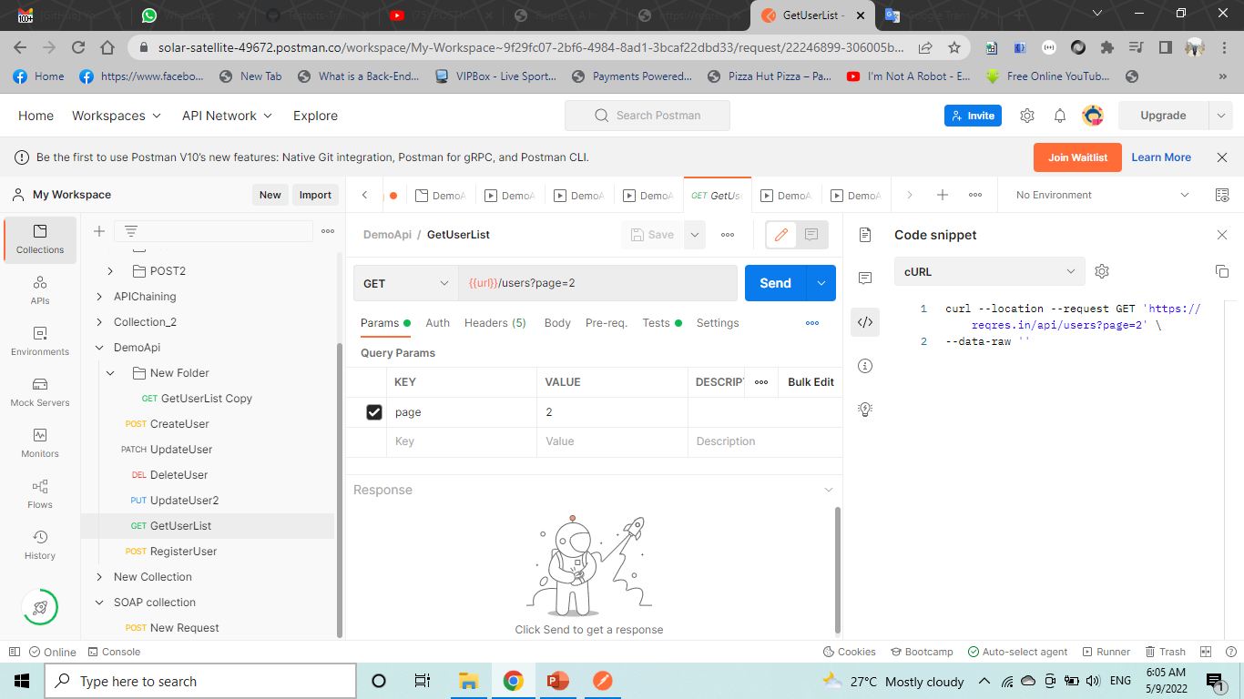

Slide 19
Click icon environment
Click global and enter variable ,initial value and current value

Slide 20
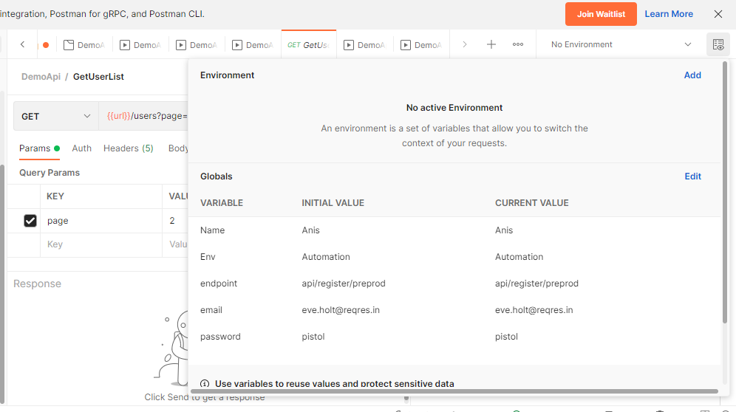

Slide 21
How to run from Command Line (Newman)
1. Install node.js
2. Install newman
3. export collection and run from commandline Newman is a command line collection runner for Postman
Step 1 : check if node.js is already installed cmd node -v npm -v Step 2 : Install node.js https://nodejs.org/en/download/ Check if node and npm are installed
Step 3 : Install Newman npm install -g newman
Step 4 : Export collection as json file
Step 5 : On cmd go to location of collection json file
Step 6 : Run command newman run collectionfilename.json

Slide 22
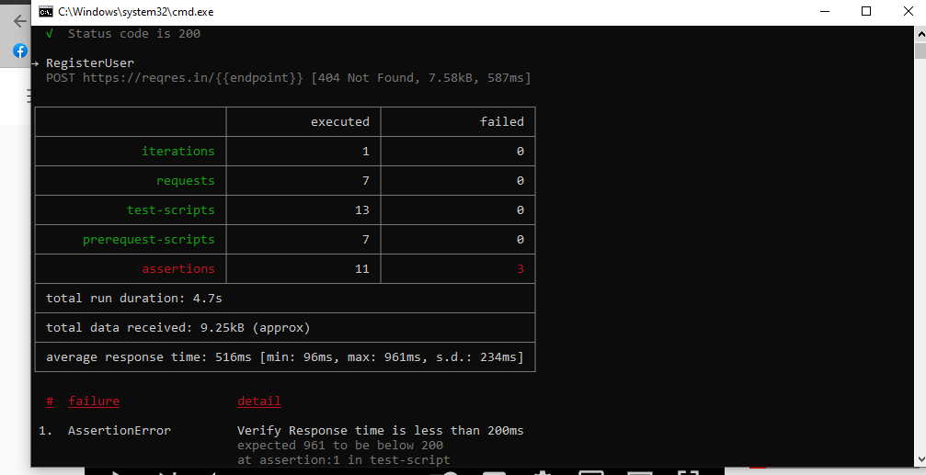
Example run in command line

Slide 23
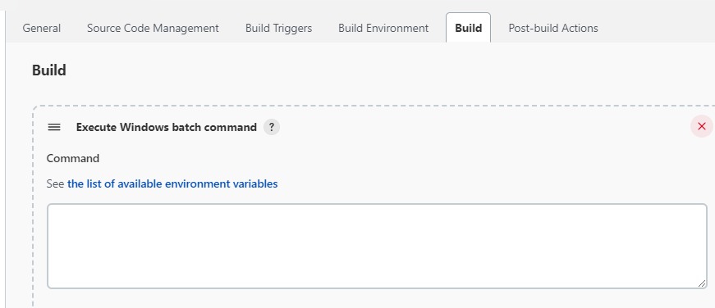
How to run from JENKINS
Click new item and enter item name
Copy adress postman

Slide 24
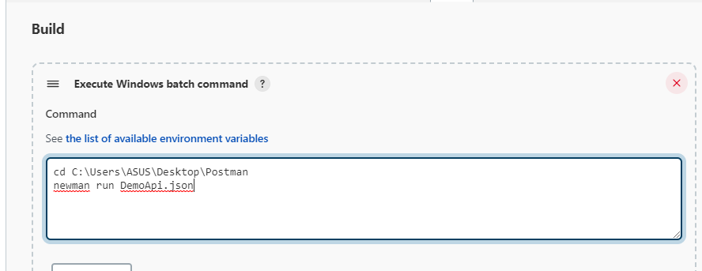

Slide 25
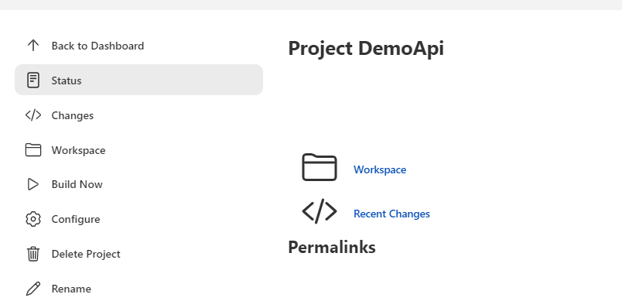
Click build now

Slide 26
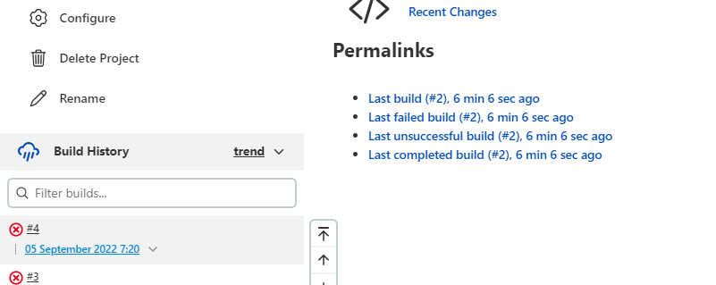
Click date

Slide 27
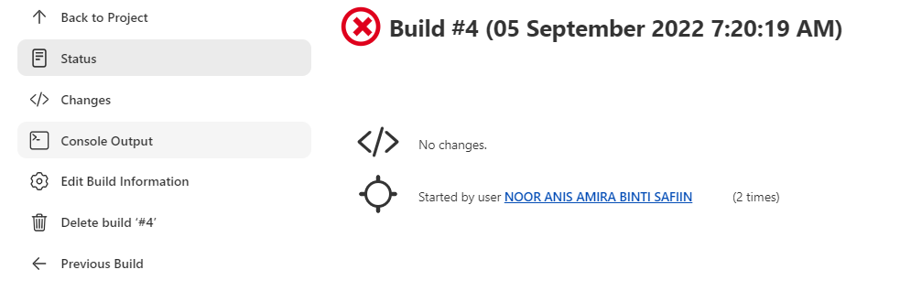
Click console ouput
Click view as text plain and click raw

Slide 28
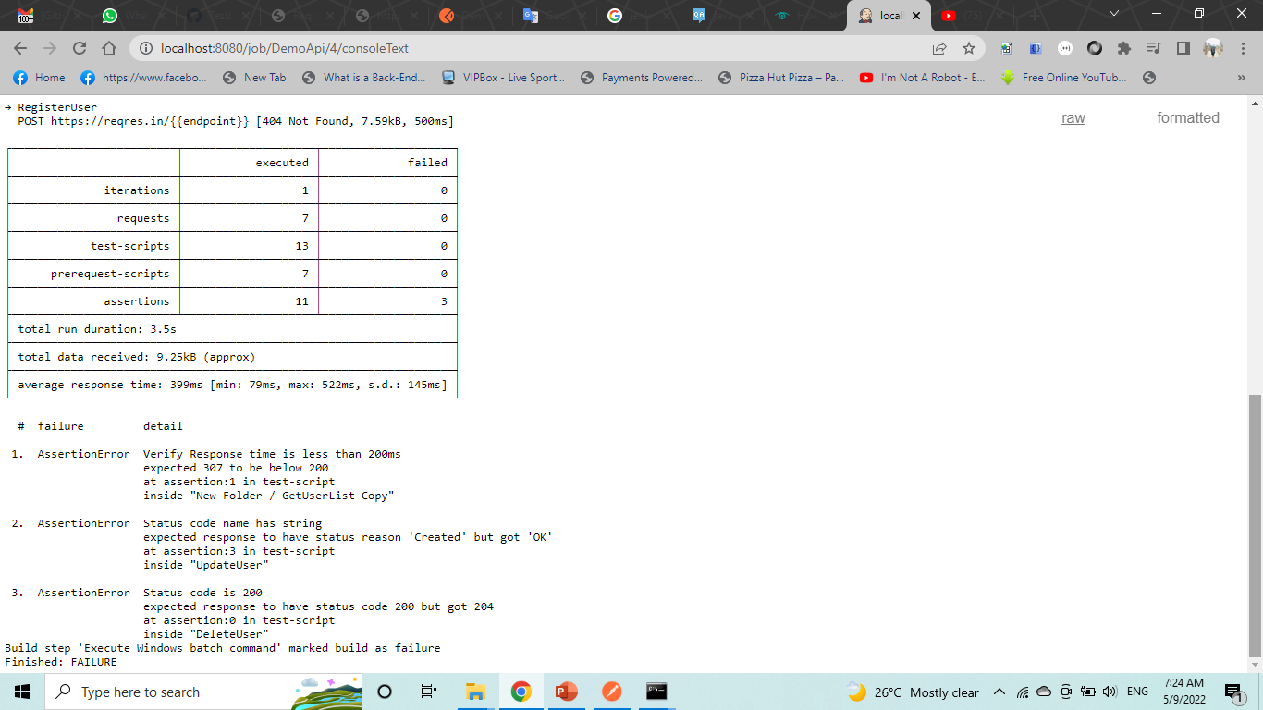

Slide 29
Run Collections Remotely with URL
Step 1 : Get your collection url
Step 2 : Get Newman and run with command newman run "url“

Slide 30
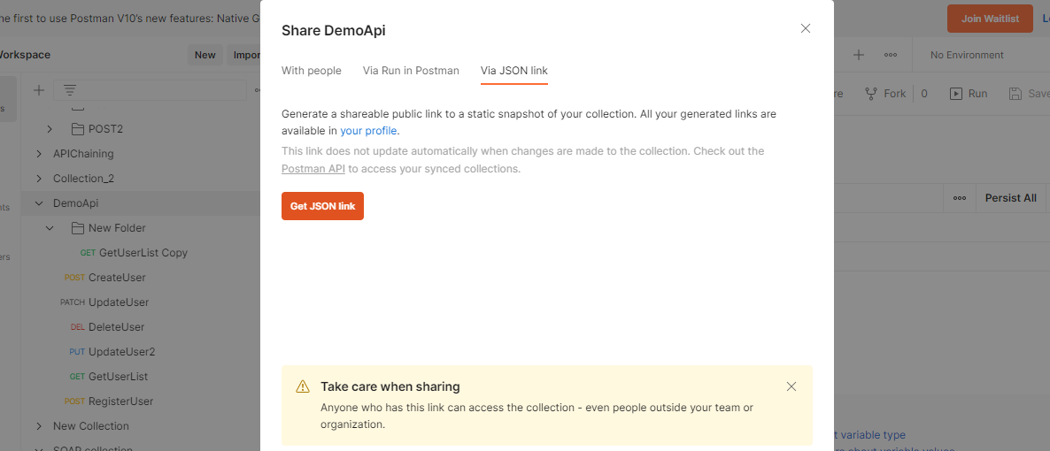

Slide 31
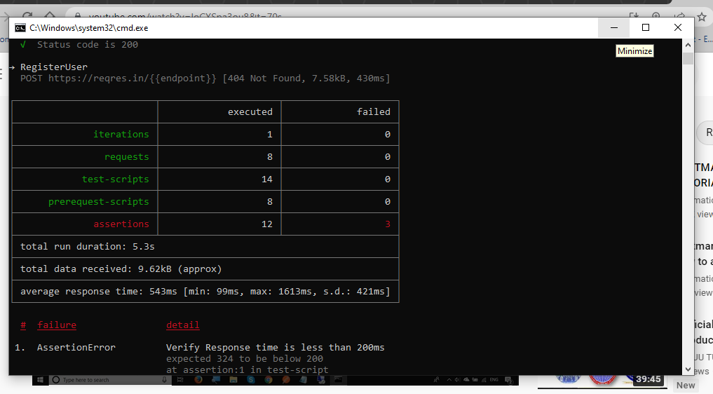

Slide 32
SOAP
1. How to add SOAP request in Postman
2. Run and Validate
Step 1 : Get Soap request url or WSDL url add to request url example : http://webservices.oorsprong.org/webs...
Step 2 : Set method as POST
Step 3 : Set body as raw and set text/xml
Step 4 : Provide request data in body
Step 5 : Run and validate
Step 6: Plugin wizdler

Slide 33
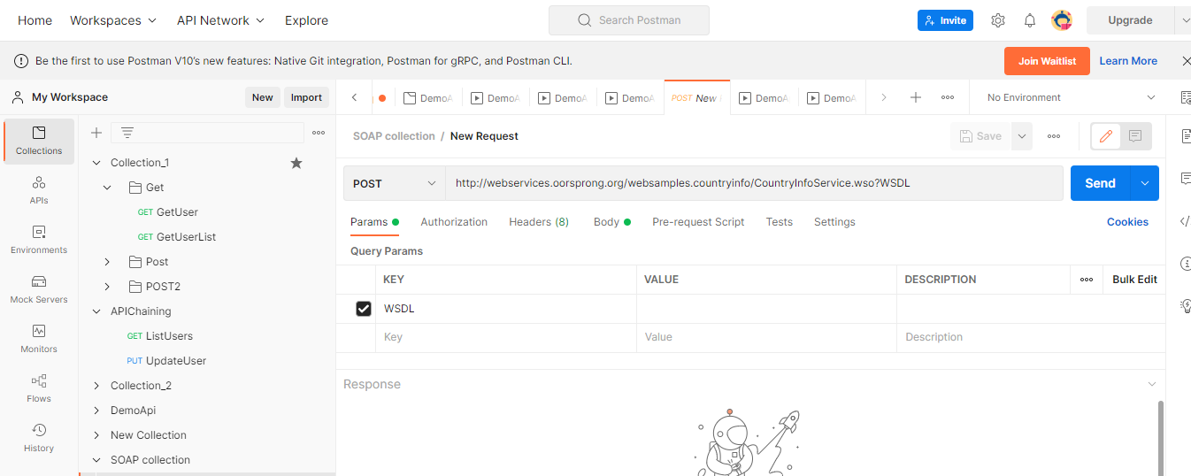

Slide 34
Go to http://webservices.oorsprong.org/webs... and click extension wizdler
Click capital city and copy capital city and paste at body soap collection body
Replace string to country code name
Click send

Slide 35
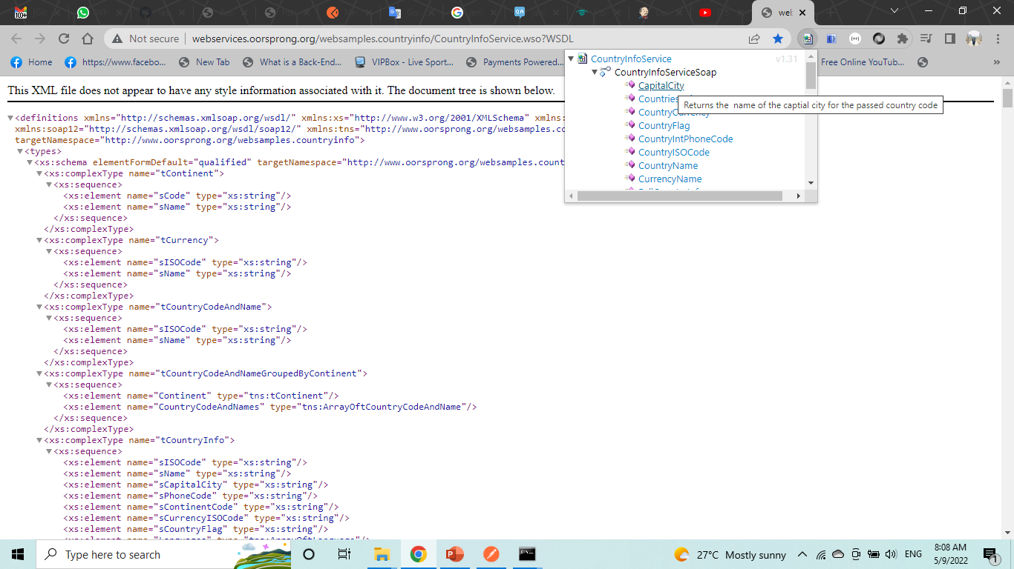
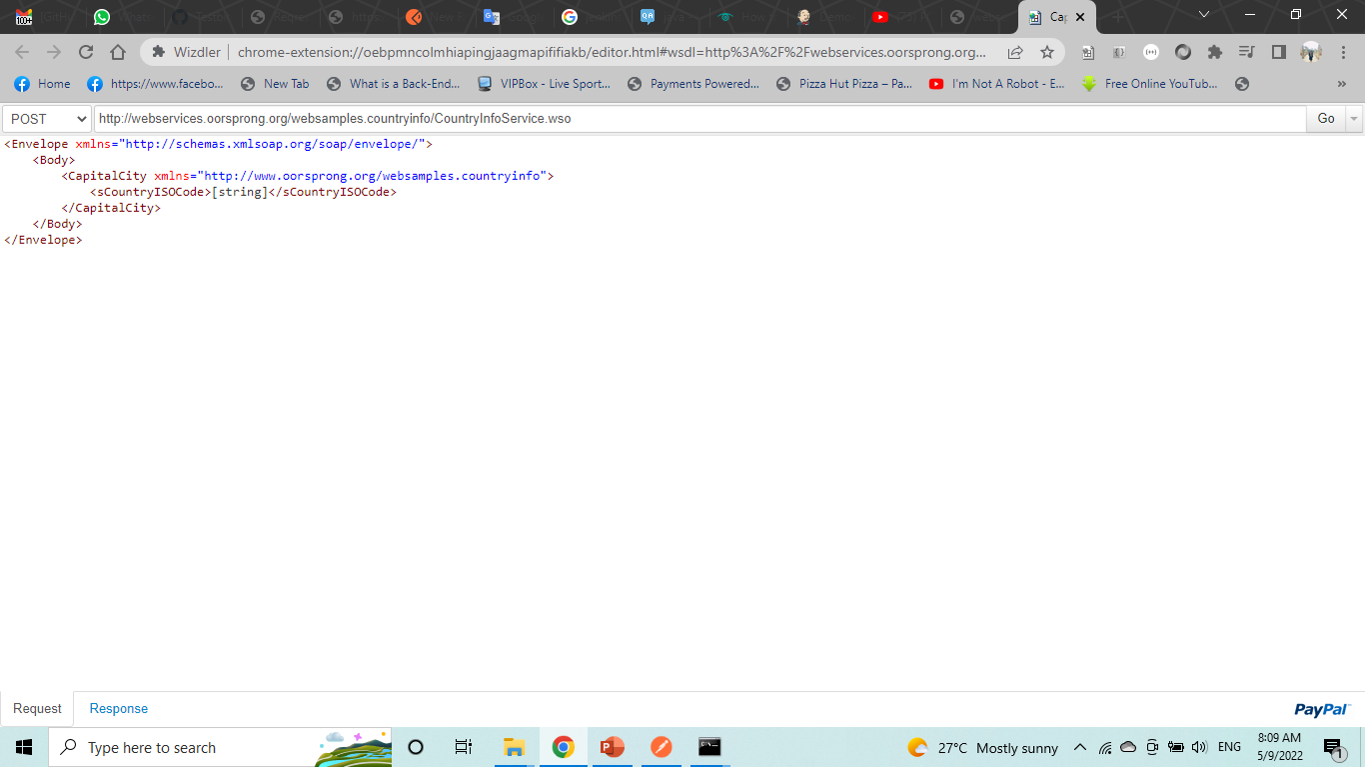

Slide 36
